Slide 2
F107 values
1. Added the f10.7 daily values from
https://lasp.colorado.edu/lisird/data/penticton_radio_flux/
which gives the daily f10.7s for a particular date
2. Also calculated the 81-day running average from these daily values
Result:
1. Automatically gives the f10.7 values for a particular day
2. Did the effect the photoelectron results since the values for the day were close to the ones I had assumed
ACE_PE report Srimoyee Samaddar
5/3/20

Slide 3
Electron Density and Electron Temperature Calculations using IRI model and Comparing with the ACE PE model
1. Compared the electron densities and electron temperatures calculated with photoelectron model with the data from the IRI model
2. Made an interface to use the FORTRAN IRI model to get the electron densities and temperatures.
3. The electron densities and electron temperatures vary in both the models
4. However, the photionization, photoelectron and pe/pi ratios are not affected.
ACE_PE report Srimoyee Samaddar
5/3/20

Slide 4
Electron Density and Electron Temperature Calculations using IRI model and Comparing with the ACE PE model
1. One Question in the approxden code:
iyyyy=fix(idate/1000)
doy=-(fix(idate)-(fix(idate/1000)*1000))
localhour=(((utsec/240. + lon)/15. + 24. ) mod 24.) ;PE Model version
; OR
localhour=(utsec/3600. + along/15.) mod 24. ;My calculation
;___________________________
In ‘my calculation of the local hour I did not get the extra 24 in circle. I am not sure what it is?
ACE_PE report Srimoyee Samaddar
5/3/20

Slide 5
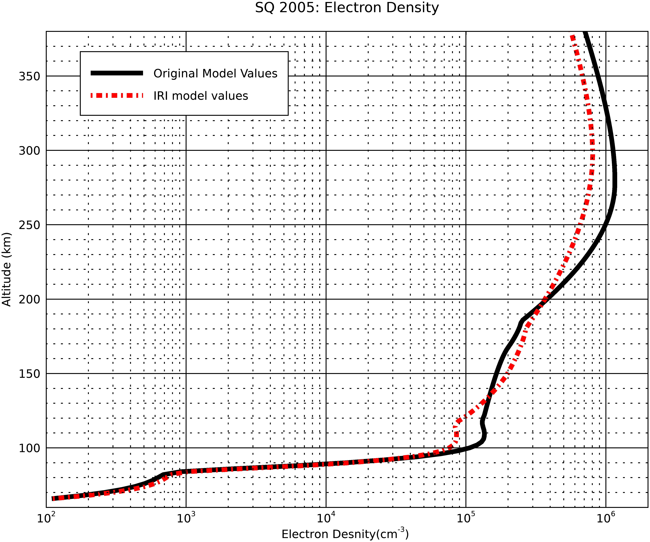
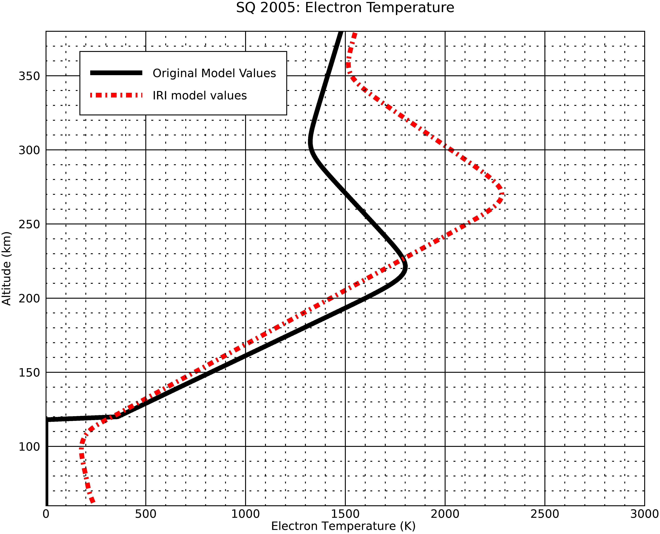
Electron Density and Electron Temperature Comparisons Results
ACE_PE report Srimoyee Samaddar
5/3/20

Slide 6
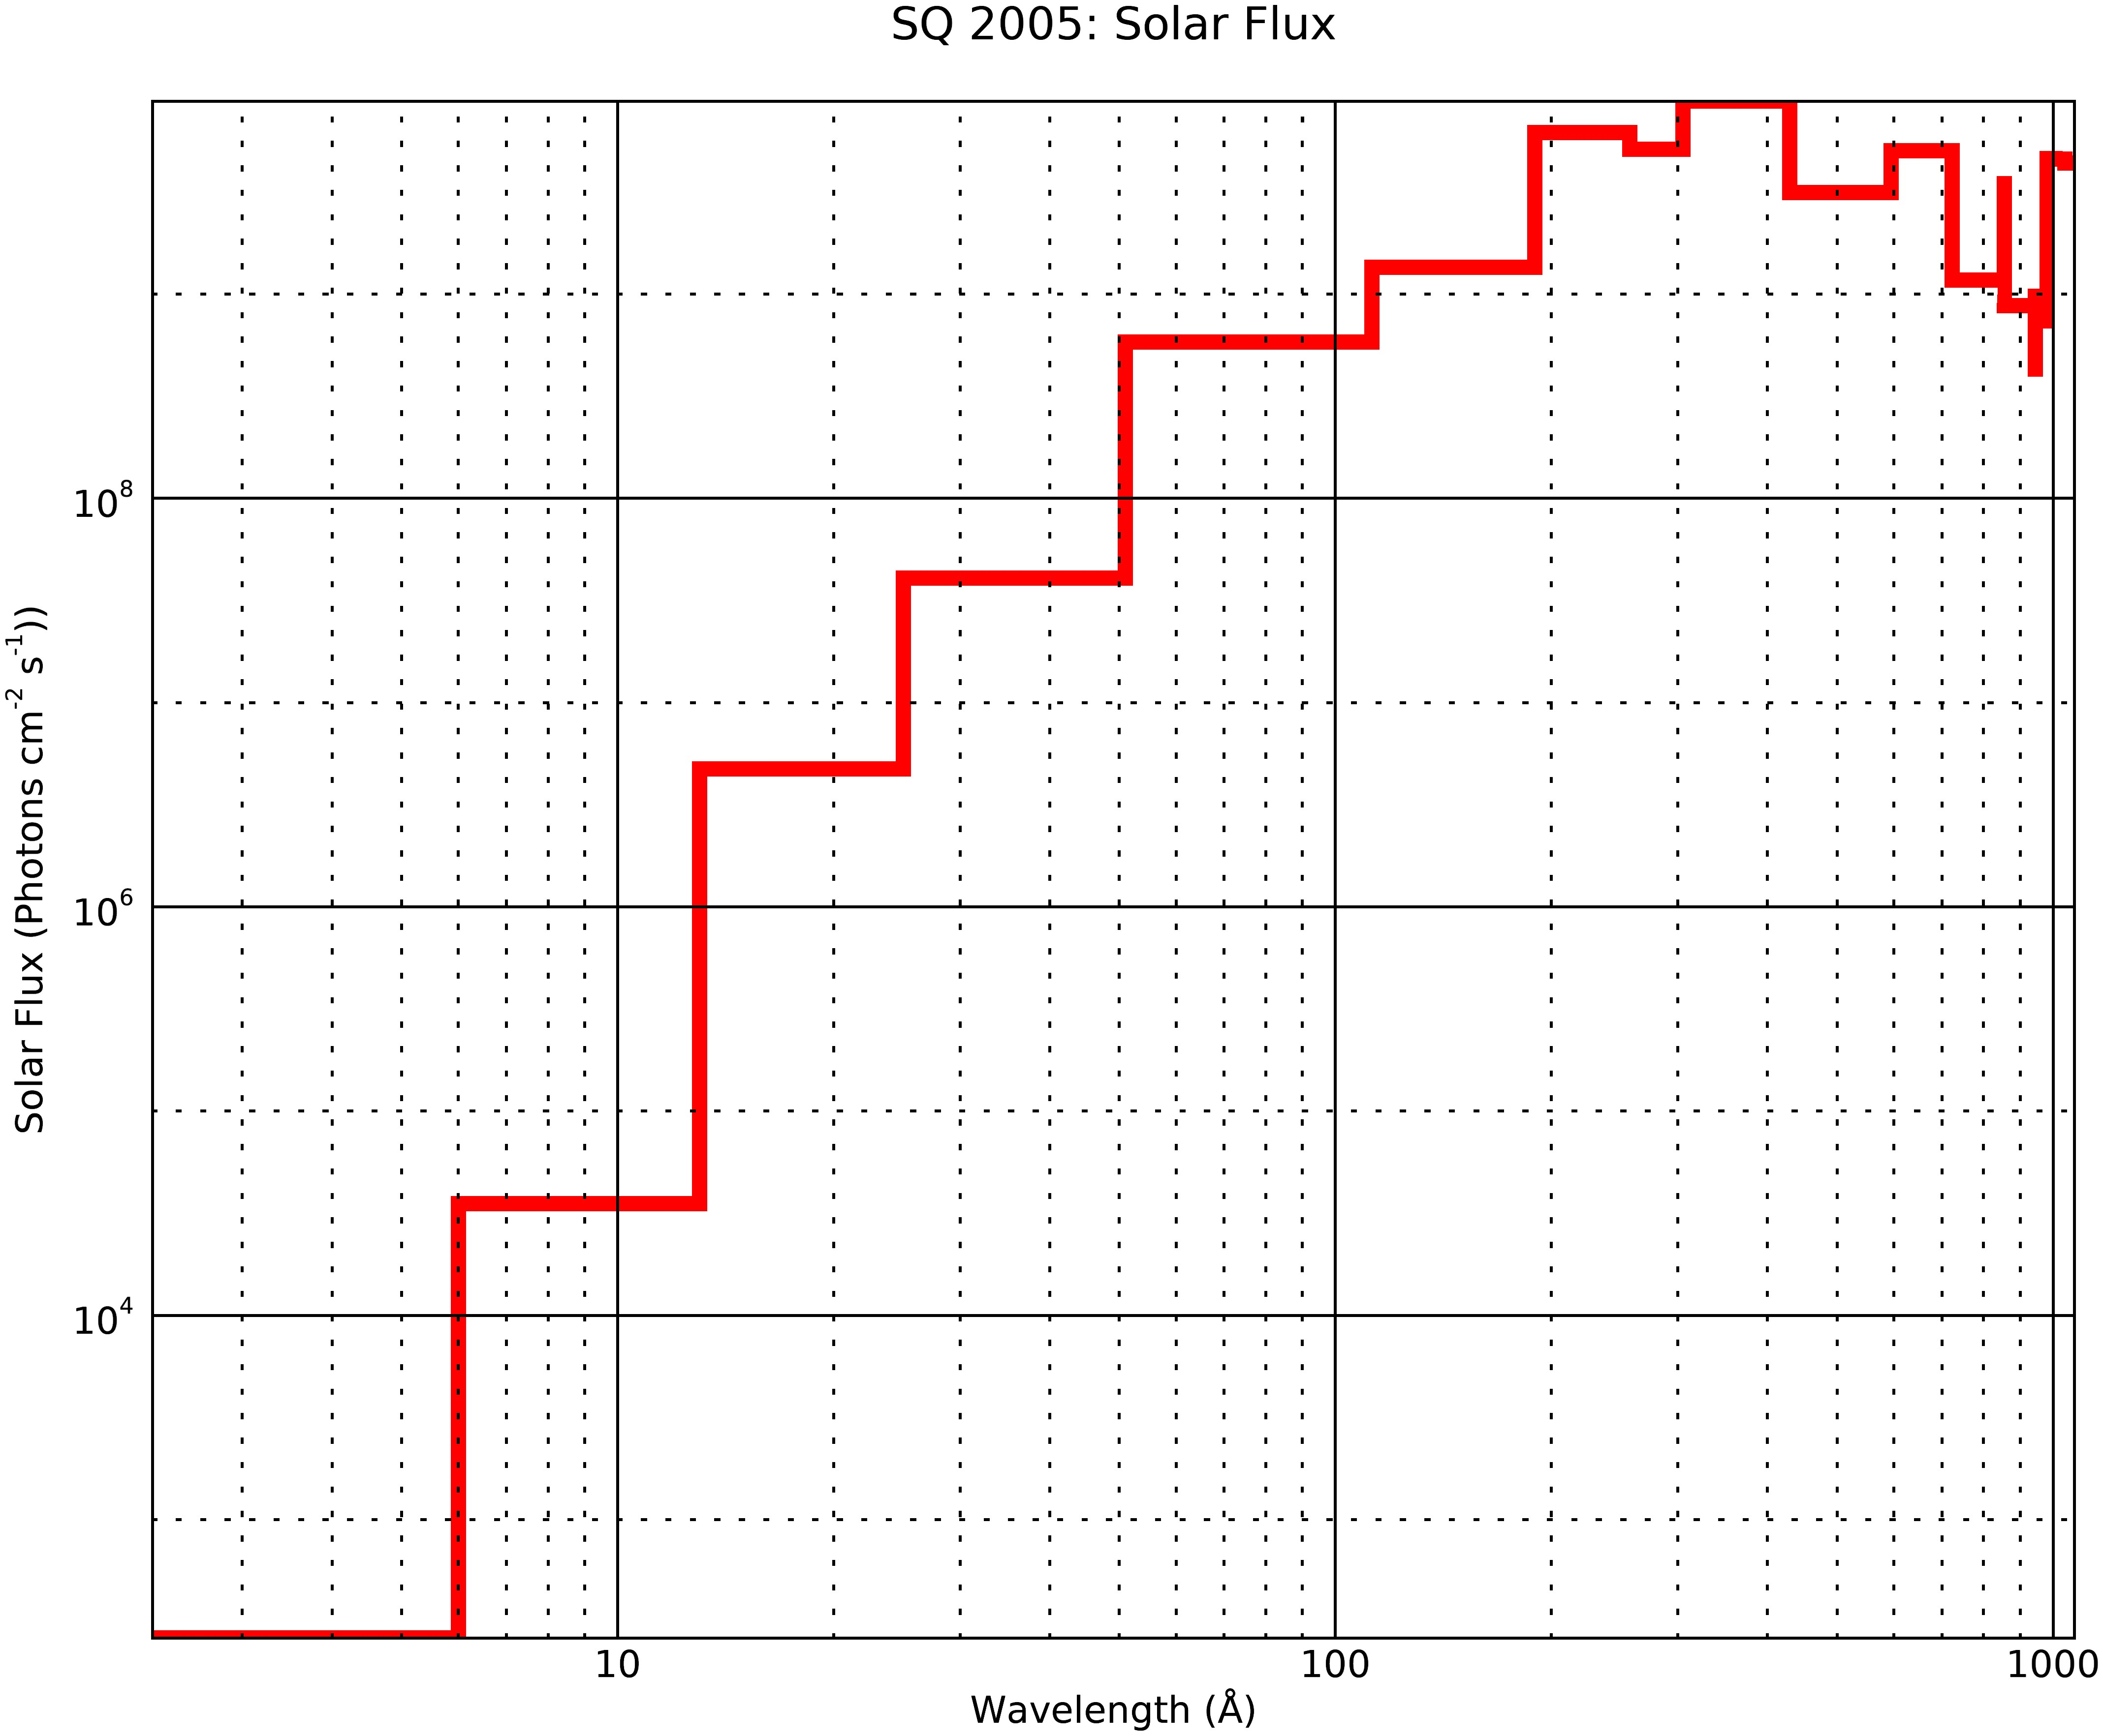
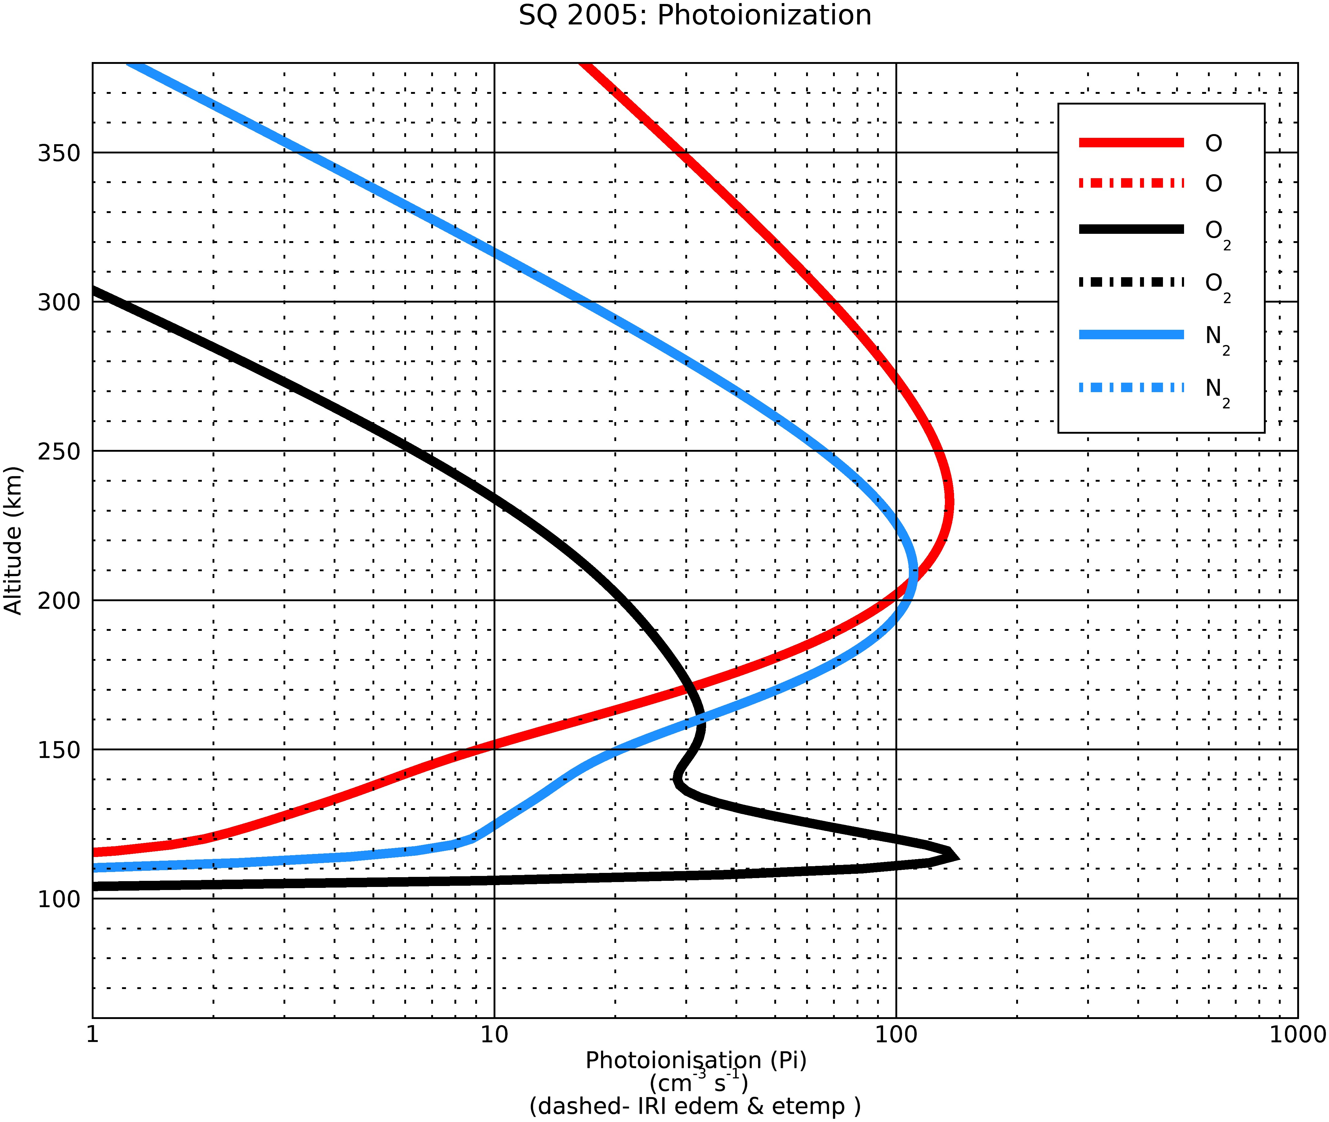
Electron Density and Electron Temperature Comparisons Results
ACE_PE report Srimoyee Samaddar
5/3/20

Slide 7
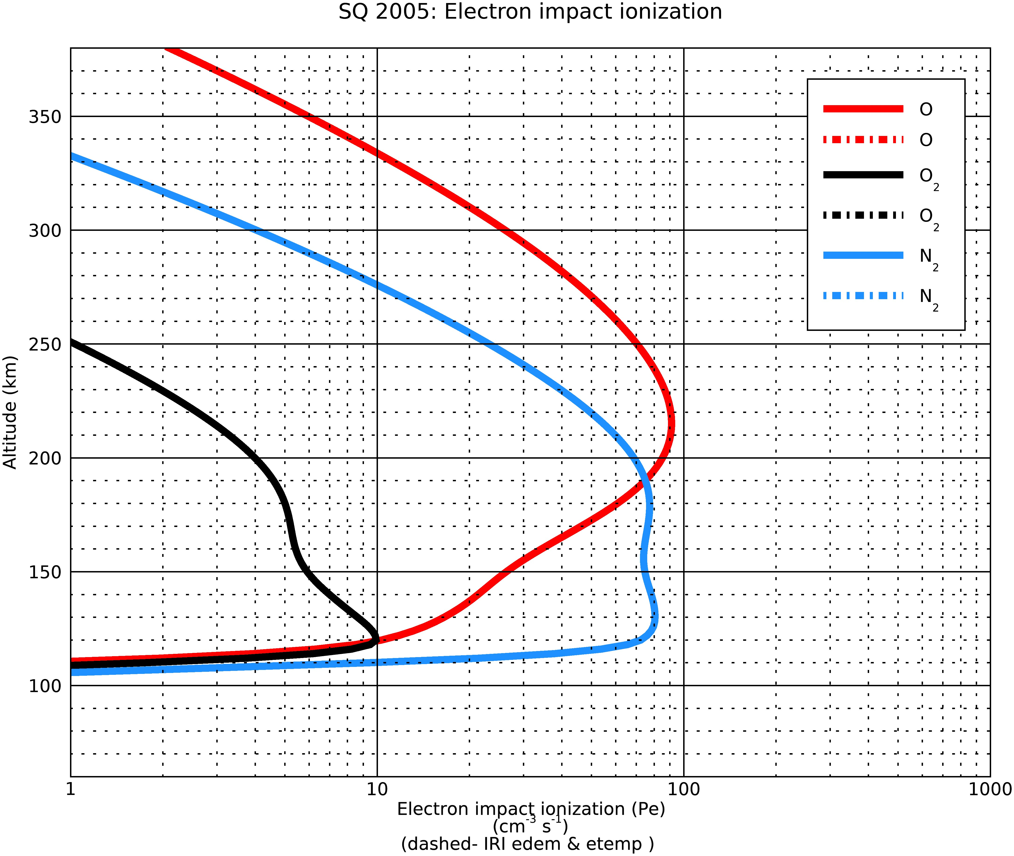
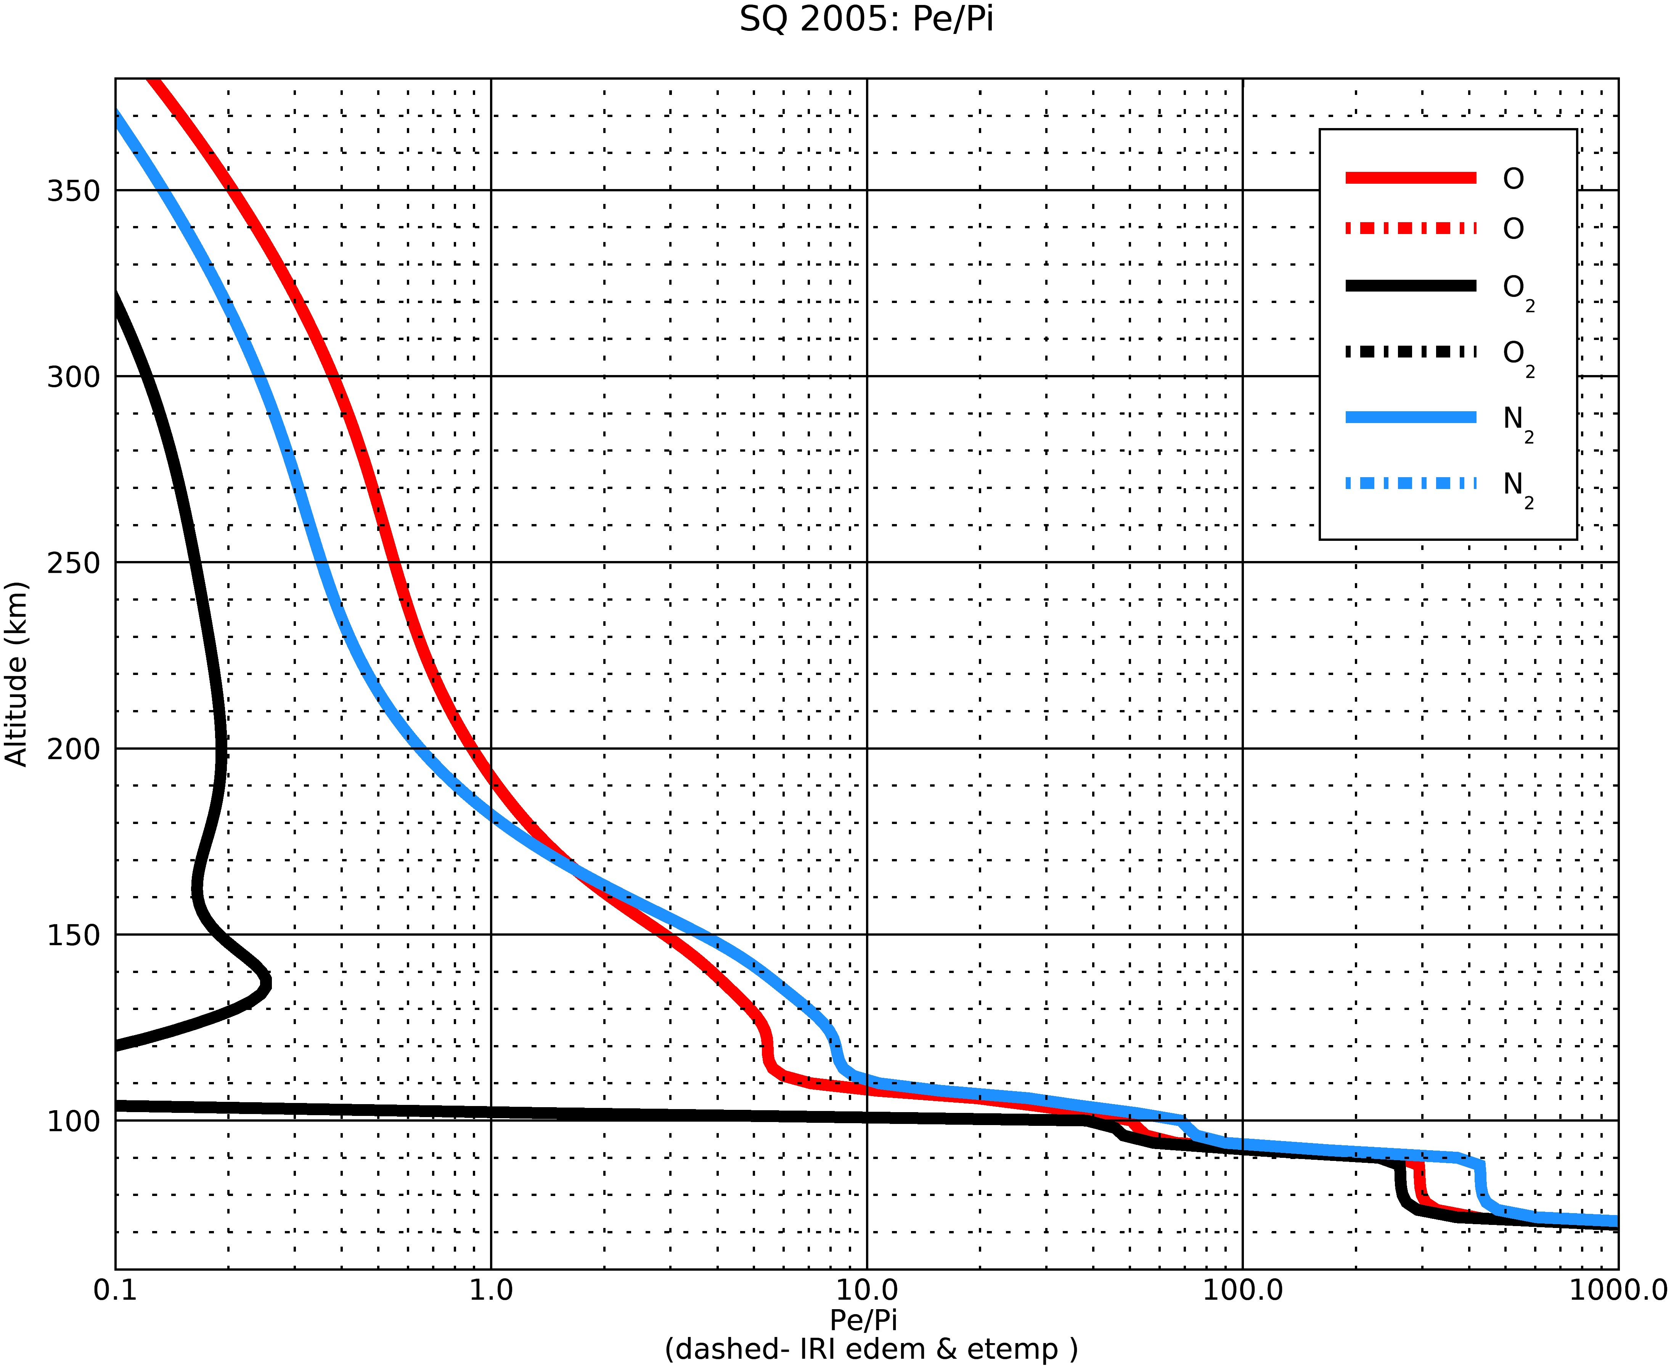
Electron Density and Electron Temperature Comparisons Results
ACE_PE report Srimoyee Samaddar
5/3/20

Slide 8
Comparisons of the pe/pi ratios of the IDL glow model, IDL glow model with IRI interface and SQ’05 paper results
O data
wave_lo | Model I (Org) pe/pi | Model II (IRI) pe/pi | SQ05 pe/pi (III) | Height | Height(Tau=1, Model II) | Model I/Model III | Model II/Model III
0.5 | 287.911 | 287.911 | 217.12 | 78 | 78 | 1.32604 | 1.32604
4 | 50.4087 | 50.4087 | 50.593 | 90 | 90 | 0.996356 | 0.996356
8 | 24.6908 | 24.6908 | 23.562 | 102 | 102 | 1.04791 | 1.04791
18 | 73.4398 | 73.4398 | 71.378 | 114 | 114 | 1.02889 | 1.02889
32 | 5.07072 | 5.07072 | 4.995 | 108 | 108 | 1.01516 | 1.01516
70 | 2.26706 | 2.26706 | 2.192 | 120 | 120 | 1.03424 | 1.03424
155 | 1.15906 | 1.15906 | 1.092 | 136 | 136 | 1.06141 | 1.06141
224 | 0.78414 | 0.78414 | 0.694 | 148 | 148 | 1.12989 | 1.12989
290 | 0.506374 | 0.506374 | 0.418 | 154 | 154 | 1.21142 | 1.21142
320 | 0.155375 | 0.155375 | 0.127 | 164 | 164 | 1.22343 | 1.22343
540 | 0 | 0 | 0 | 170 | 170 | 0 | 0
ACE_PE report Srimoyee Samaddar
5/3/20

Slide 9
Comparisons of the pe/pi ratios of the IDL glow model, IDL glow model with IRI interface and SQ’05 paper results
O2 data
wave_lo | Model I Org) pe/pi | Model II (IRI) pe/pi | SQ05 pe/pi (III) | Height | Height(Tau=1, Model II) | Model I/Model III | Model II/Model III
0.5 | 255.866 | 255.866 | 210.83 | 78 | 78 | 1.21361 | 1.21361
4 | 43.7843 | 43.7843 | 50.156 | 90 | 90 | 0.872962 | 0.872962
8 | 21.4887 | 21.4887 | 20.29 | 102 | 102 | 1.05908 | 1.05908
18 | 63.7336 | 63.7336 | 59.953 | 114 | 114 | 1.06306 | 1.06306
32 | 4.28988 | 4.28988 | 4.271 | 108 | 108 | 1.00442 | 1.00442
70 | 1.6802 | 1.6802 | 1.613 | 120 | 120 | 1.04166 | 1.04166
155 | 0.621613 | 0.621613 | 0.579 | 136 | 136 | 1.0736 | 1.0736
224 | 0.277783 | 0.277783 | 0.242 | 148 | 148 | 1.14786 | 1.14786
290 | 0.135069 | 0.135069 | 0.105 | 154 | 154 | 1.28637 | 1.28637
320 | 0.0310659 | 0.0310659 | 0.024 | 164 | 164 | 1.29441 | 1.29441
540 | 0 | 0 | 0 | 170 | 170 | 0 | 0
ACE_PE report Srimoyee Samaddar
5/3/20

Slide 10
Comparisons of the pe/pi ratios of the IDL glow model,
IDL glow model with IRI interface and SQ’05 paper results
N2 data
wave_lo | Model I (Org) pe/pi | Model II (IRI) pe/pi | SQ05 pe/pi (III) | Height | Height(Tau=1, Model II) | Model I/Model III | Model II/Model III
0.5 | 417.762 | 417.762 | 342.66 | 78 | 78 | 1.21917 | 1.21917
4 | 68.4776 | 68.4776 | 80.88 | 90 | 90 | 0.846657 | 0.846657
8 | 32.1722 | 32.1722 | 32.126 | 102 | 102 | 1.00144 | 1.00144
18 | 11.2645 | 11.2645 | 10.834 | 114 | 114 | 1.03973 | 1.03973
32 | 7.86467 | 7.86467 | 7.789 | 108 | 108 | 1.00971 | 1.00971
70 | 2.95828 | 2.95828 | 2.859 | 120 | 120 | 1.03473 | 1.03473
155 | 0.995094 | 0.995094 | 0.933 | 136 | 136 | 1.06655 | 1.06655
224 | 0.409681 | 0.409681 | 0.361 | 148 | 148 | 1.13485 | 1.13485
290 | 0.224721 | 0.224721 | 0.178 | 154 | 154 | 1.26248 | 1.26248
320 | 0.0398586 | 0.0398586 | 0.031 | 164 | 164 | 1.28576 | 1.28576
540 | 0 | 0 | 0 | 170 | 170 | 0 | 0
ACE_PE report Srimoyee Samaddar
5/3/20

Slide 11
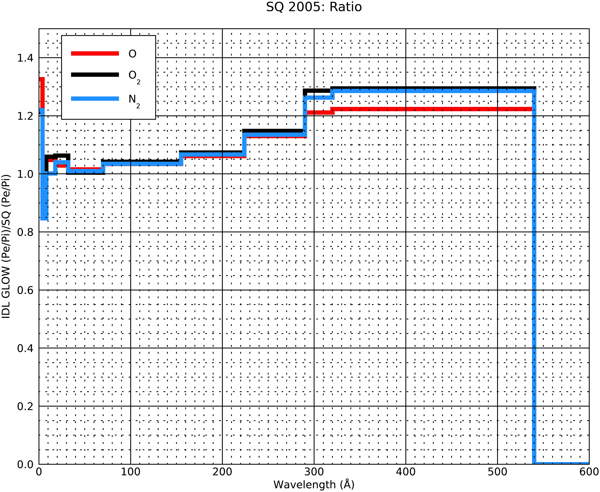
Error plots between IDL glow and SQ’05 pe/pi ratios data
ACE_PE report Srimoyee Samaddar
5/3/20

Slide 12
#1
if (chi ge 2.) then begin
zcol=zcol+1.0e30
return
endif
; #2
if chi le !pi/2.0 then begin
for i=0,nmaj-1 do zcol[i,*]=zvcd[i,*]*chapman(chi,zz,tn,i)
endif else begin ;#3
for j=0,jmax-1 do begin
ghrg=(re+zz(j))*sin(chi)
ghz=ghrg-re
if (ghz le 0.) then begin
for i=0,nmaj-1 do begin
zcol(i,j) = 1.0e30
endfor
goto,line220
endif
if (ghz ge zz(0)) then begin
for jjjg=0,j-2 do begin
if (zz(jjjg) le ghz and zz(jjjg+1) gt ghz) then jg=jjjg
endfor
tng = tn(jg)+(tn(jg+1)-tn(jg))*(ghz-zz(jg))/(zz(jg+1)-zz(jg))
for i=0,nmaj-1 do begin
zcg(i) = zvcd(i,jg) * (zvcd(i,jg+1) / zvcd(i,jg)) ^ $
((ghz-zz(jg)) / (zz(jg+1)-zz(jg)))
endfor
endif else begin ;#5
for jjjg=0,2 do begin
if (zus(jjjg) lt ghz and zus(jjjg+1) gt ghz) then jg=jjjg
endfor
tng = tnus(jg) + $
(tnus(jg+1)-tnus(jg))*(ghz-zus(jg))/(zus(jg+1)-zus(jg))
for i=0,nmaj-1 do begin
zcg(i) = zcus(i,jg) * (zcus(i,jg+1) / zcus(i,jg)) ^ $
((ghz-zus(jg)) / (zus(jg+1)-zus(jg)))
endfor
endelse ;#5
for i=0,nmaj-1 do begin
zcol(i,j) = 2. * zcg(i) * chapman(!pi/2.,ghz,tng,i) $
- zvcd(i,j) * chapman(chi,zz(j),tn(j),i)
endfor
line220:
endfor ; altitude loop
endelse ; chi greater than pi/2
; #1
if chi le !pi/2.0 then begin
for i=0,nmaj-1 do zcol[i,*]=zvcd[i,*]*chapman(chi,zz,tn,i)
endif
if ((chi gt !pi/2.0) and (chi lt 2.)) then begin ;#2
for j=0,jmax-1 do begin ;altitude loop
grflag =0 ; this is a flag that tracks the grazing conditon; executes the Chapman function only when flag=1
ghrg=(re+zz(j))*sin(chi)
ghz=ghrg-re
if (ghz le 0.) then begin
zcol(*,j) = 1.0e30
; endif else $ ;begin $
if (ghz ge zz(0)) then begin ; grazing >zz[0] ;***
grflag =1
; for jjjg=0,j-2 do begin
if (zz(jjjg) le ghz and zz(jjjg+1) gt ghz) then jg=jjjg
endfor
tng =$ tn(jg)+(tn(jg+1)-tn(jg))*(ghz-zz(jg))/(zz(jg+1)-zz(jg))
for i=0,nmaj-1 do $
zcg(i) = zvcd(i,jg) * (zvcd(i,jg+1) / zvcd(i,jg)) ^ $
((ghz-zz(jg)) / (zz(jg+1)-zz(jg)))
endif else begin ;grazing< zz[0]
grflag =1
; print,'entered loop3'
for jjjg=0,2 do begin
if (zus(jjjg) lt ghz and zus(jjjg+1) gt ghz) then jg=jjjg
endfor
tng = tnus(jg) + (tnus(jg+1)-tnus(jg))*(ghz-zus(jg))/(zus(jg+1)-zus(jg))
for i=0,nmaj-1 do $
zcg(i) = zcus(i,jg) * (zcus(i,jg+1) / zcus(i,jg)) ^ $
((ghz-zus(jg)) / (zus(jg+1)-zus(jg)))
endelse ;***
; if (grflag eq 1) then begin
for i=0,nmaj-1 do begin
zcol(i,j) = 2. * zcg(i) * chapman(!pi/2.,ghz,tng,i) $
- zvcd(i,j) * chapman(chi,zz(j),tn(j),i)
endfor
endif
endfor ; altitude loop;#2
endif else begin ; (chi ge 2.) #3
zcol=zcol+1.0e30
endelse

Slide 13
Column Density Diagnostics- Results of Removing the GOTO statements
Slide 8
Model I (Org) pe/pi
287.911
50.4087
24.6908
73.4398
5.07072
2.26706
1.15906
0.78414
0.506374
0.155375
0
O data
wave_lo | wave_hi | Model I pe/pi | SQ05 pe/pi (II) | Height(Tau=1, Model II) | Model I/Model II
0.5 | 4 | 287.916 | 217.12 | 78 | 1.32607
4 | 8 | 50.4089 | 50.593 | 90 | 0.996361
8 | 18 | 24.6911 | 23.562 | 102 | 1.04792
18 | 32 | 73.4415 | 71.378 | 114 | 1.02891
32 | 70 | 5.07074 | 4.995 | 108 | 1.01516
70 | 155 | 2.26708 | 2.192 | 120 | 1.03425
155 | 224 | 1.15907 | 1.092 | 136 | 1.06142
224 | 290 | 0.784147 | 0.694 | 148 | 1.1299
290 | 320 | 0.506379 | 0.418 | 154 | 1.21143
320 | 540 | 0.155377 | 0.127 | 164 | 1.22344
540 | 650 | 0 | 0 | 170 | 0
ACE_PE report Srimoyee Samaddar
5/3/20

Slide 14
Column Density Diagnostics- Results of Removing the GOTO statements
Slide 9
Model I Org) pe/pi
255.866
43.7843
21.4887
63.7336
4.28988
1.6802
0.621613
0.277783
0.135069
0.0310659
0
O2 data
wave_lo | wave_hi | Model I pe/pi | SQ05 pe/pi (II) | Height(Tau=1, Model II) | Model I/Model II
0.5 | 4 | 255.871 | 210.83 | 78 | 1.21364
4 | 8 | 43.7845 | 50.156 | 90 | 0.872966
8 | 18 | 21.4889 | 20.29 | 102 | 1.05909
18 | 32 | 63.7351 | 59.953 | 114 | 1.06308
32 | 70 | 4.2899 | 4.271 | 108 | 1.00442
70 | 155 | 1.68021 | 1.613 | 120 | 1.04167
155 | 224 | 0.621618 | 0.579 | 136 | 1.07361
224 | 290 | 0.277785 | 0.242 | 148 | 1.14787
290 | 320 | 0.13507 | 0.105 | 154 | 1.28638
320 | 540 | 0.0310663 | 0.024 | 164 | 1.29443
540 | 650 | 0 | 0 | 170 | 0
ACE_PE report Srimoyee Samaddar
5/3/20

Slide 15
Column Density Diagnostics- Results of Removing the GOTO statements
N2 data
wave_lo | wave_hi | Model I pe/pi | SQ05 pe/pi (II) | Height(Tau=1, Model II) | Model I/Model II
0.5 | 4 | 417.77 | 342.66 | 78 | 1.2192
4 | 8 | 68.4779 | 80.88 | 90 | 0.846661
8 | 18 | 32.1726 | 32.126 | 102 | 1.00145
18 | 32 | 11.2647 | 10.834 | 114 | 1.03976
32 | 70 | 7.8647 | 7.789 | 108 | 1.00972
70 | 155 | 2.9583 | 2.859 | 120 | 1.03473
155 | 224 | 0.995101 | 0.933 | 136 | 1.06656
224 | 290 | 0.409685 | 0.361 | 148 | 1.13486
290 | 320 | 0.224723 | 0.178 | 154 | 1.26249
320 | 540 | 0.0398591 | 0.031 | 164 | 1.28578
540 | 650 | 0 | 0 | 170 | 0
Slide 10
Model I (Org) pe/pi
417.762
68.4776
32.1722
11.2645
7.86467
2.95828
0.995094
0.409681
0.224721
0.0398586
0
ACE_PE report Srimoyee Samaddar
5/3/20

Slide 16
Column Density Diagnostics- Results of Removing the GOTO statements
1. If you compare the pe/pi ratios of :
a. Slide 8 and slide 13
b. Slide 9 and slide 14
c. Slide 10 and slide 15
The pe/pi ratios changes slightly. I thought it was interesting what removing the GOTO statement does, but I do not know why!!
2. One of the error function condition for the Chapman function calculation Smith and Smith [JGR 77, 3592, 1972]was missing
5/3/20

Slide 17
Column Density Diagnostics- Vertical Column Densities Calculation
1. Original Vertical Column Densities calculation – the number densities for O at the lowest altitudes are all zeros , so vertical densities calculations was giving divided by zero error
for i=0,nmaj-1 do begin
zvcd[i,jmax-1] = zmaj[i,jmax-1] $
* (zz[jmax-1]-zz[jmax-2]) $
/ alog(zmaj[i,jmax-2]/zmaj[i,jmax-1])
for j=jmax-2,0,-1 do begin
rat = zmaj[i,j+1] / zmaj[i,j]
zvcd[i,j] = zvcd[i,j+1] $
+ zmaj[i,j] * (zz[j]-zz[j+1]) / alog(rat) * (1.-rat)
endfor
endfor
Divided by zero error
5/3/20

Slide 18
Column Density Diagnostics- Vertical Column Densities Calculation
1. Made that Vertical Column Densities (VCD) equal to the higher altitudes where the they were the number densities were zero
for i=0,nmaj-1 do begin
zvcd[i,jmax-1] = zmaj[i,jmax-1] $
* (zz[jmax-1]-zz[jmax-2]) $
/ alog(zmaj[i,jmax-2]/zmaj[i,jmax-1])
for j=jmax-2,0,-1 do begin
if zmaj[i,j] ne 0. then begin ;added this check: Srimoyee
rat = zmaj[i,j+1] / zmaj[i,j]
zvcd[i,j] = zvcd[i,j+1] $
+ zmaj[i,j] * (zz[j]-zz[j+1]) / alog(rat) * (1.-rat)
endif
endfor
endfor
; adding the column densities for lower altitudes to be constant when the densities at lower altitudes become zero
for i=0, nmaj-1 do begin
zvcd_ind=where(reform(zvcd(i,*)) eq 0, ct_i)
if ct_i gt 0 then $
zvcd[i,zvcd_ind]=zvcd[i,zvcd_ind[-1]+1]
endfor
2. Calculated the VCD by simple summation/ integration over the altitudes
; calculating the vertical column density given by:
; n(z0)H(z0)=integrate[n(z0)exp(-(z-z0)/H) dz] from z=z0 to infinity OR
; integrate[n(z)*dz] from z=z0 to infinity
;#1 simple summation
for i=0, jmax-2 do begin
for j= i, jmax-2 do begin
zvcd[*,i]= zvcd[*,i]+(zmaj[*,j] * (zz[j+1]-zz[j]))
endfor
endfor
zvcd[*,jmax-1]= zvcd[*,jmax-1]+(zmaj[*,jmax-1] * (zz[jmax-1]-zz[jmax-2]))
3. Used int_tabulated (IDL) to get the VCD
; calculating the vertical column density given by:
; n(z0)H(z0)=integrate[n(z0)exp(-(z-z0)/H) dz] from z=z0 to infinity OR
; integrate[n(z)*dz] from z=z0 to infinity
;#2 using int_tabulated
for i=0, jmax-2 do begin
for j= 0, nmaj-1 do begin
zvcd[j,i]= int_tabulated(zz[i:jmax-1],zmaj[j,i:jmax-1])
endfor
endfor
zvcd[*,jmax-1]= zvcd[*,jmax-1]+(zmaj[*,jmax-1] * (zz[jmax-1]-zz[jmax-2]))
5/3/20

Slide 19
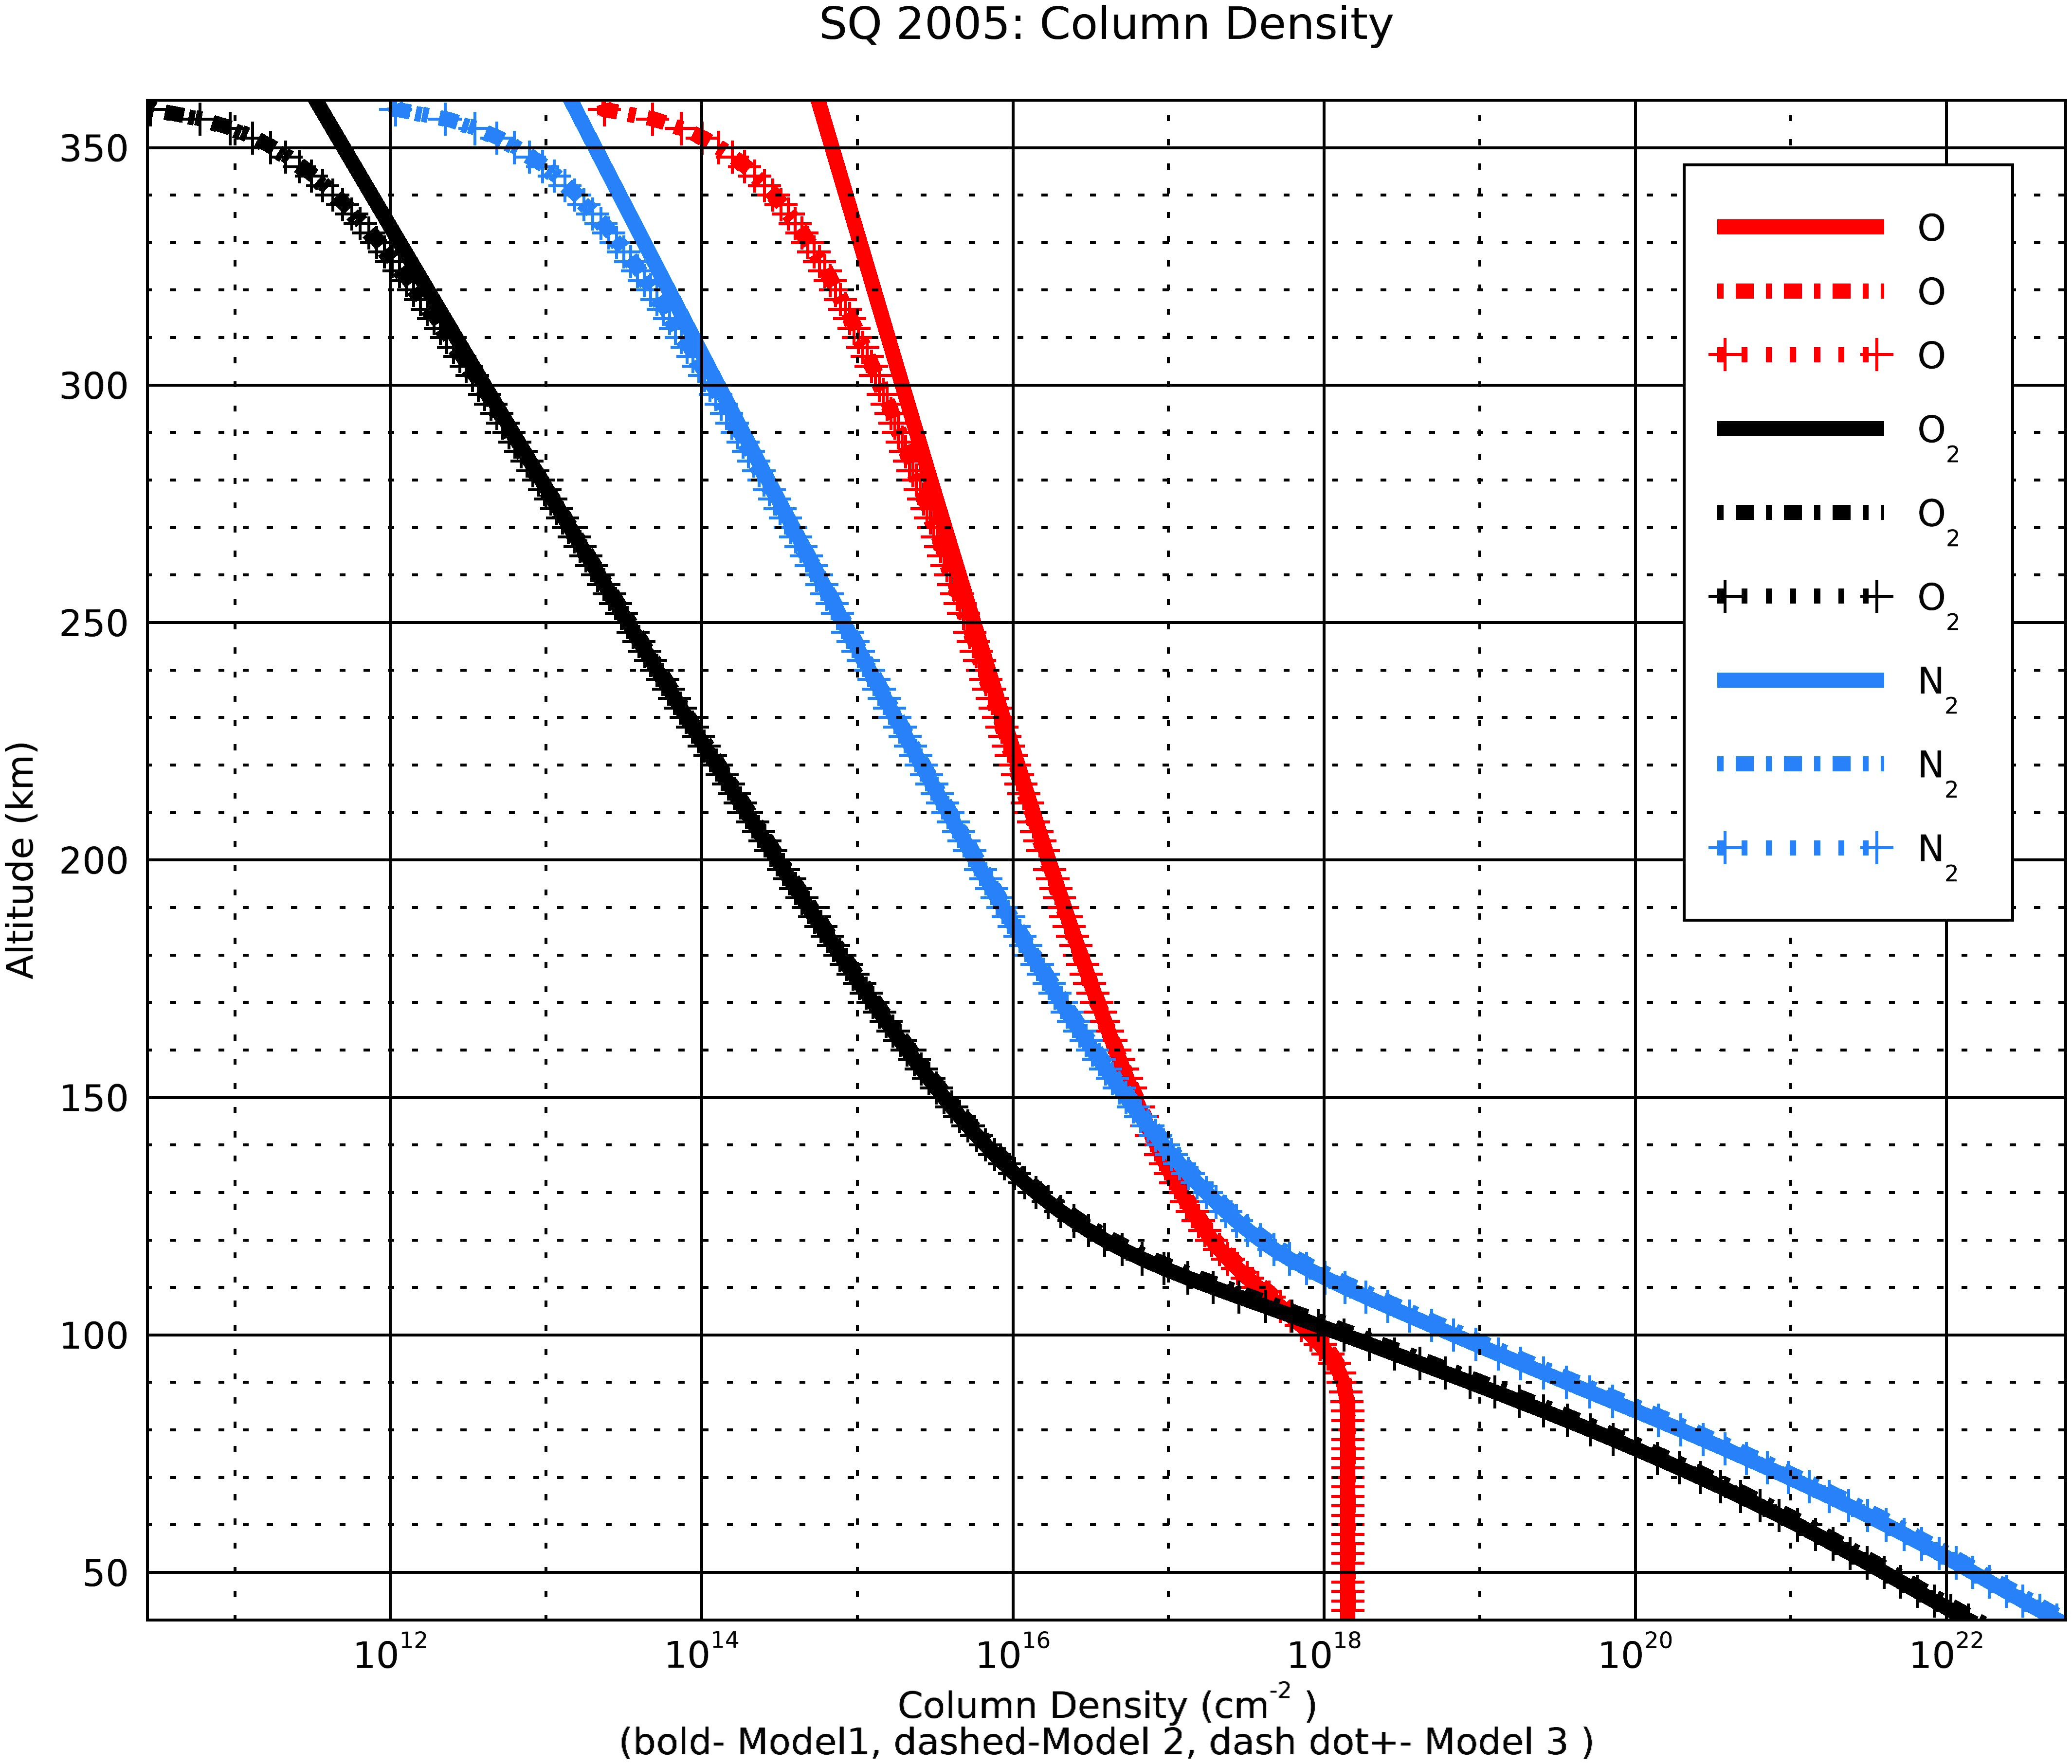
Column Density Plots- 3 ways
5/3/20

Slide 20
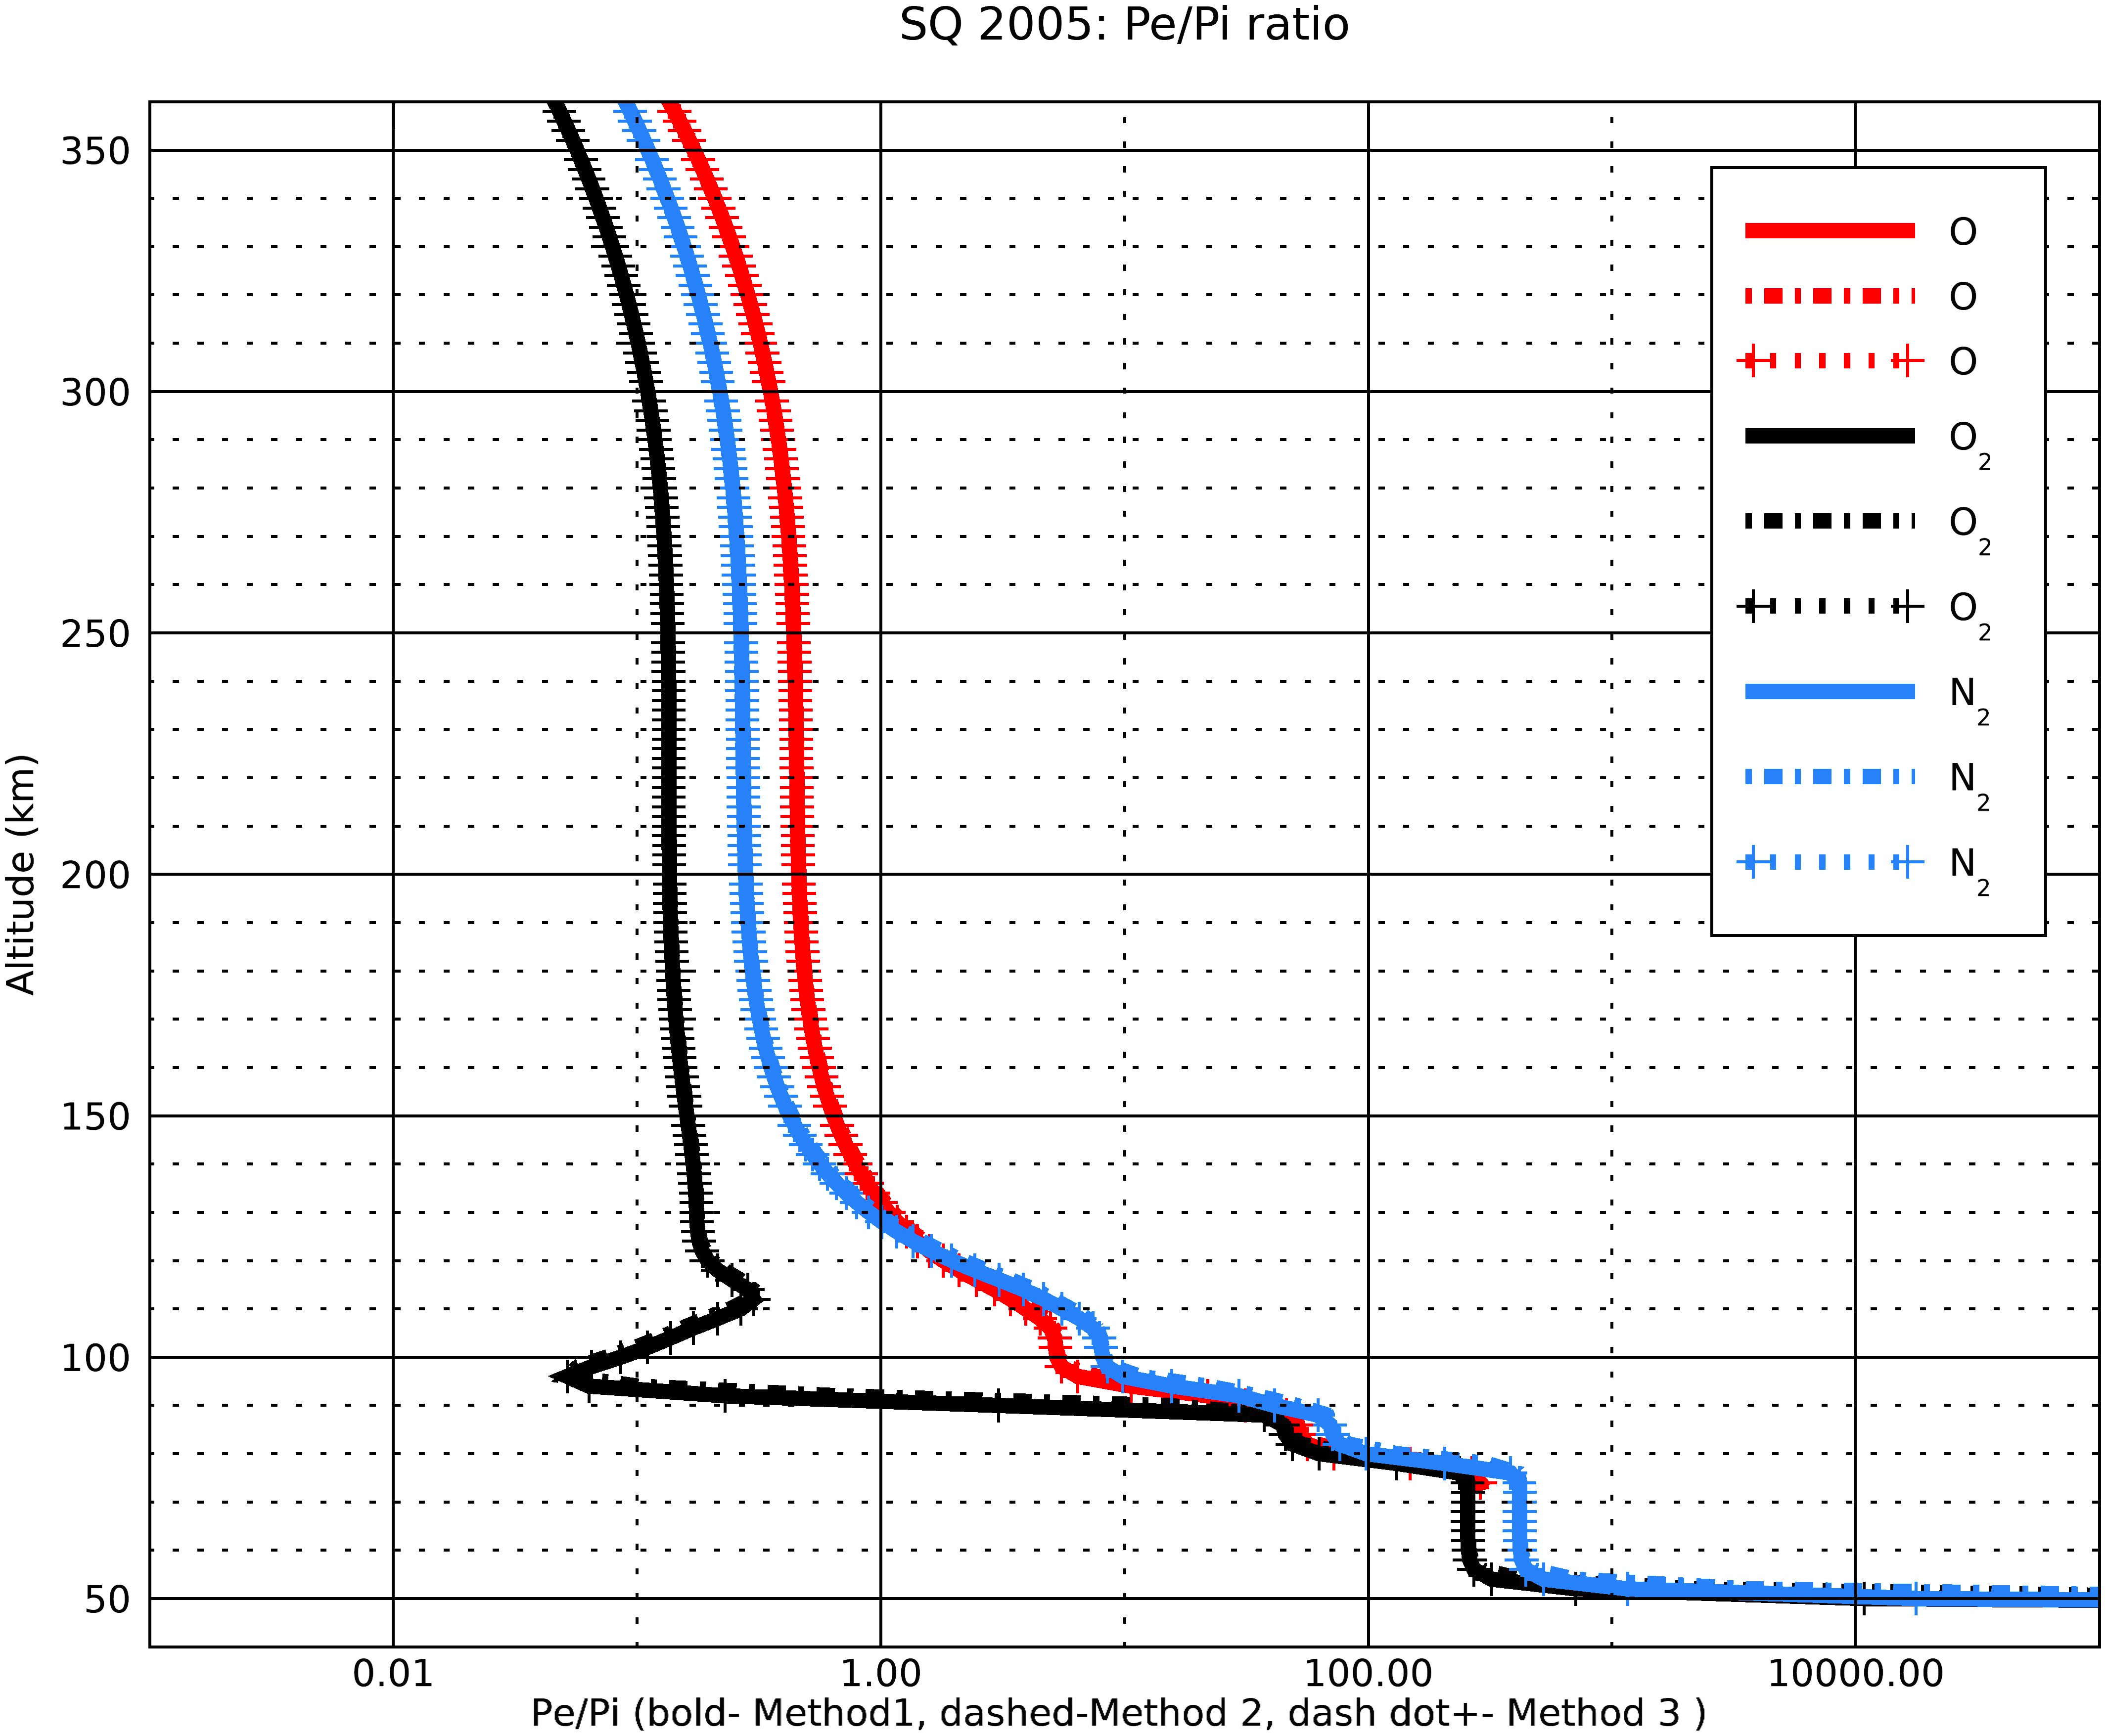
Pe/Pi ratios Plots- 3 ways
5/3/20

Slide 21
Pe/Pi ratios at unit optical depth- 3 ways
O data
wave_lo | wave_hi | Method 1 pe/pi | Method 2 pe/pi | Method 3 pe/pi | Height(Tau=1, Model 1) | Height(Tau=1, Model 2) | Height(Tau=1, Method 3)
0.5 | 4 | 287.914 | 287.931 | 287.914 | 78 | 80 | 78
4 | 8 | 50.4088 | 50.3866 | 50.4088 | 90 | 92 | 90
8 | 18 | 24.691 | 24.6978 | 24.691 | 102 | 102 | 102
18 | 32 | 73.4408 | 73.4844 | 73.4407 | 114 | 114 | 114
32 | 70 | 5.07074 | 5.07126 | 5.07074 | 108 | 108 | 108
70 | 155 | 2.26707 | 2.26746 | 2.26707 | 120 | 120 | 120
155 | 224 | 1.15906 | 1.1627 | 1.15906 | 136 | 138 | 136
224 | 290 | 0.784142 | 0.785784 | 0.784141 | 148 | 150 | 148
290 | 320 | 0.506375 | 0.506443 | 0.506375 | 154 | 154 | 154
320 | 540 | 0.155375 | 0.155403 | 0.155375 | 164 | 164 | 164
540 | 650 | 0 | 0 | 0 | 170 | 170 | 168
5/3/20

Slide 22
Pe/Pi ratios at unit optical depth- 3 ways
O2 data
wave_lo | wave_hi | Method 1 pe/pi | Method 2 pe/pi | Method 3 pe/pi | Height(Tau=1, Model 1) | Height(Tau=1, Model 2) | Height(Tau=1, Method 3)
0.5 | 4 | 255.869 | 255.899 | 255.869 | 78 | 80 | 78
4 | 8 | 43.7844 | 43.7751 | 43.7844 | 90 | 92 | 90
8 | 18 | 21.4888 | 21.4947 | 21.4889 | 102 | 102 | 102
18 | 32 | 63.7345 | 63.7711 | 63.7344 | 114 | 114 | 114
32 | 70 | 4.28989 | 4.29031 | 4.28989 | 108 | 108 | 108
70 | 155 | 1.68021 | 1.68047 | 1.68021 | 120 | 120 | 120
155 | 224 | 0.621615 | 0.623769 | 0.621614 | 136 | 138 | 136
224 | 290 | 0.277783 | 0.278483 | 0.277783 | 148 | 150 | 148
290 | 320 | 0.135069 | 0.135086 | 0.135069 | 154 | 154 | 154
320 | 540 | 0.0310659 | 0.0310714 | 0.0310659 | 164 | 164 | 164
540 | 650 | 0 | 0 | 0 | 170 | 170 | 168
5/3/20

Slide 23
Pe/Pi ratios at unit optical depth- 3 ways
N2 data
wave_lo | wave_hi | Method 1 pe/pi | Method 2 pe/pi | Method 3 pe/pi | Height(Tau=1, Model 1) | Height(Tau=1, Model 2) | Height(Tau=1, Method 3)
0.5 | 4 | 417.766 | 417.807 | 417.767 | 78 | 80 | 78
4 | 8 | 68.4778 | 68.4589 | 68.4778 | 90 | 92 | 90
8 | 18 | 32.1725 | 32.1813 | 32.1725 | 102 | 102 | 102
18 | 32 | 11.2646 | 11.2712 | 11.2646 | 114 | 114 | 114
32 | 70 | 7.86468 | 7.86545 | 7.86469 | 108 | 108 | 108
70 | 155 | 2.95829 | 2.95875 | 2.95829 | 120 | 120 | 120
155 | 224 | 0.995097 | 0.998506 | 0.995096 | 136 | 138 | 136
224 | 290 | 0.409682 | 0.410685 | 0.409682 | 148 | 150 | 148
290 | 320 | 0.224722 | 0.224751 | 0.224721 | 154 | 154 | 154
320 | 540 | 0.0398586 | 0.0398656 | 0.0398586 | 164 | 164 | 164
540 | 650 | 0 | 0 | 0 | 170 | 170 | 168
5/3/20

Slide 24
Column Density Diagnostics- Vertical Column Densities Calculations
1. The column densities are significantly different at the higher altitudes but at the lower altitudes, all three methods give the same column densities.
2. The Pe/Pi ratios are almost not affected at all.
3. I took the solar zenith angle to be 0.
4. Question: Which method to use?
Also are methods 2 and 3 correct?
5. Also note, for the calculation of scale height it was assumed that the species have different scale heights >=100 km
5/3/20

Slide 25
Column Density Diagnostics- Pe/Pi ratios for different zenith angles
1. I calculated the pe/pi ratios for different solar zenith angles.
2. The pe/pi ratios hardly changed.
3. Conclusion: I fixed the NAN values at the lowest altitudes of the
Column densities calculation
The pe/pi ratios are pretty much constant
Only the first 2 bins are varying a lot from the SQ’05 paper
There are no bugs in the calculation of the column densities
5/3/20

Slide 26
O data |  | Solar Zenith Angle
wave_lo | wave_hi | 1.pe/pi ( sza= 4.38414) | 2. pe/pi ( sza= 16.6414) | 3. pe/pi ( sza= 31.3674) | 1.Height(Tau=1) | 2.Height(Tau=1) | 3.Height(Tau=1)
0.5 | 4 | 287.916 | 288.062 | 288.149 | 78 | 78 | 80
4 | 8 | 50.4089 | 50.4529 | 50.4697 | 90 | 90 | 92
8 | 18 | 24.6911 | 24.7271 | 24.7651 | 102 | 102 | 102
18 | 32 | 73.4415 | 73.2759 | 73.0988 | 114 | 114 | 116
32 | 70 | 5.07074 | 5.08268 | 5.09602 | 108 | 108 | 108
70 | 155 | 2.26708 | 2.27113 | 2.28361 | 120 | 120 | 122
155 | 224 | 1.15907 | 1.16531 | 1.17179 | 136 | 138 | 140
224 | 290 | 0.784147 | 0.787837 | 0.791428 | 148 | 150 | 152
290 | 320 | 0.506379 | 0.507978 | 0.510899 | 154 | 154 | 156
320 | 540 | 0.155377 | 0.15584 | 0.156611 | 164 | 164 | 168
540 | 650 | 0 | 0 | 0 | 170 | 170 | 172
650 | 798 | 0 | 0 | 0 | 164 | 164 | 168

Slide 27
O data
wave_lo | wave_hi | 4. pe/pi ( sza= 46.2581) | 5.pe/pi (sza= 61.1930) | 6. pe/pi (sza= 76.1470) | 4.Height(Tau=1) | 5.Height(Tau=1) | 6.Height(Tau=1)
0.5 | 4 | 288.397 | 288.768 | 290.146 | 80 | 82 | 86
4 | 8 | 50.495 | 50.5198 | 50.6498 | 92 | 94 | 98
8 | 18 | 24.8218 | 24.8947 | 25.0788 | 104 | 106 | 110
18 | 32 | 72.9576 | 72.9178 | 72.7437 | 118 | 120 | 128
32 | 70 | 5.11597 | 5.13762 | 5.22022 | 110 | 112 | 120
70 | 155 | 2.30514 | 2.32884 | 2.41883 | 126 | 130 | 144
155 | 224 | 1.18232 | 1.20817 | 1.25754 | 144 | 154 | 170
224 | 290 | 0.798329 | 0.809811 | 0.831042 | 158 | 168 | 184
290 | 320 | 0.516817 | 0.526604 | 0.546064 | 162 | 172 | 190
320 | 540 | 0.157503 | 0.158828 | 0.160028 | 174 | 184 | 202
540 | 650 | 0 | 0 | 0 | 178 | 190 | 208
650 | 798 | 0 | 0 | 0 | 172 | 182 | 200

Slide 28
O2 data
wave_lo | wave_hi | 1. pe/pi (sza= 4.38414) | 2. pe/pi (sza= 16.6414) | 3. pe/pi (sza= 31.3674) | 1.Height(Tau=1) | 2.Height(Tau=1) | 3.Height(Tau=1)
0.5 | 4 | 255.871 | 255.989 | 256.07 | 78 | 78 | 80
4 | 8 | 43.7845 | 43.818 | 43.8384 | 90 | 90 | 92
8 | 18 | 21.4889 | 21.5163 | 21.5467 | 102 | 102 | 102
18 | 32 | 63.7351 | 63.5728 | 63.4365 | 114 | 114 | 116
32 | 70 | 4.2899 | 4.29908 | 4.30974 | 108 | 108 | 108
70 | 155 | 1.68021 | 1.68285 | 1.69255 | 120 | 120 | 122
155 | 224 | 0.621617 | 0.625192 | 0.628899 | 136 | 138 | 140
224 | 290 | 0.277785 | 0.279293 | 0.280756 | 148 | 150 | 152
290 | 320 | 0.13507 | 0.135529 | 0.136287 | 154 | 154 | 156
320 | 540 | 0.0310663 | 0.0311827 | 0.0313228 | 164 | 164 | 168
540 | 650 | 0 | 0 | 0 | 170 | 170 | 172
650 | 798 | 0 | 0 | 0 | 164 | 164 | 168

Slide 29
O2 data
wave_lo | wave_hi | 4. pe/pi (sza= 46.2581) | 5. pe/pi (sza= 61.1930) | 6. pe/pi (sza= 76.1470) | 4.Height(Tau=1) | 5.Height(Tau=1) | 6.Height(Tau=1)
0.5 | 4 | 256.287 | 256.635 | 257.912 | 80 | 82 | 86
4 | 8 | 43.8592 | 43.8925 | 44.0361 | 92 | 94 | 98
8 | 18 | 21.6063 | 21.6819 | 21.867 | 104 | 106 | 110
18 | 32 | 63.3343 | 63.3224 | 63.2416 | 118 | 120 | 128
32 | 70 | 4.32889 | 4.3497 | 4.42822 | 110 | 112 | 120
70 | 155 | 1.70971 | 1.72838 | 1.79792 | 126 | 130 | 144
155 | 224 | 0.634997 | 0.650002 | 0.678339 | 144 | 154 | 170
224 | 290 | 0.283648 | 0.288476 | 0.297334 | 158 | 168 | 184
290 | 320 | 0.137738 | 0.140105 | 0.144794 | 162 | 172 | 190
320 | 540 | 0.0314558 | 0.0316235 | 0.0316533 | 174 | 184 | 202
540 | 650 | 0 | 0 | 0 | 178 | 190 | 208
650 | 798 | 0 | 0 | 0 | 172 | 182 | 200

Slide 30
N2 data
wave_lo | wave_hi | 1.pe/pi (sza= 4.38414) | 2.pe/pi (sza= 16.6414) | 3.pe/pi (sza= 31.3674) | 1.Height(Tau=1) | 2.Height(Tau=1) | 3.Height(Tau=1)
0.5 | 4 | 417.77 | 417.97 | 418.1 | 78 | 78 | 80
4 | 8 | 68.4779 | 68.5325 | 68.562 | 90 | 90 | 92
8 | 18 | 32.1726 | 32.215 | 32.2616 | 102 | 102 | 102
18 | 32 | 11.2647 | 11.2366 | 11.2121 | 114 | 114 | 116
32 | 70 | 7.8647 | 7.88176 | 7.90148 | 108 | 108 | 108
70 | 155 | 2.9583 | 2.96301 | 2.97997 | 120 | 120 | 122
155 | 224 | 0.995101 | 1.00078 | 1.00667 | 136 | 138 | 140
224 | 290 | 0.409685 | 0.411861 | 0.413972 | 148 | 150 | 152
290 | 320 | 0.224723 | 0.225474 | 0.226742 | 154 | 154 | 156
320 | 540 | 0.0398591 | 0.0400002 | 0.0401702 | 164 | 164 | 168
540 | 650 | 0 | 0 | 0 | 170 | 170 | 172
650 | 798 | 0 | 0 | 0 | 164 | 164 | 168

Slide 31
N2 data
wave_lo | wave_hi | 4.pe/pi (sza= 46.2581) | 5. pe/pi ( sza= 61.1930) | 6. pe/pi ( sza= 76.1470) | 4.Height(Tau=1) | 5.Height(Tau=1) | 6.Height(Tau=1)
0.5 | 4 | 418.456 | 419.014 | 421.069 | 80 | 82 | 86
4 | 8 | 68.5951 | 68.6424 | 68.8548 | 92 | 94 | 98
8 | 18 | 32.3476 | 32.457 | 32.7269 | 104 | 106 | 110
18 | 32 | 11.1936 | 11.191 | 11.1753 | 118 | 120 | 128
32 | 70 | 7.93596 | 7.97344 | 8.11507 | 110 | 112 | 120
70 | 155 | 3.0099 | 3.04251 | 3.16418 | 126 | 130 | 144
155 | 224 | 1.01634 | 1.04014 | 1.08513 | 144 | 154 | 170
224 | 290 | 0.418126 | 0.425059 | 0.437782 | 158 | 168 | 184
290 | 320 | 0.229199 | 0.233226 | 0.241239 | 162 | 172 | 190
320 | 540 | 0.0403319 | 0.0405349 | 0.0405565 | 174 | 184 | 202
540 | 650 | 0 | 0 | 0 | 178 | 190 | 208
650 | 798 | 0 | 0 | 0 | 172 | 182 | 200

